Slide 1
SMCE SangMyeong Coding Education
Week 9 < String, 2 Dimension Array, Pointer >
2023.1.11.

Slide 2
SangMyeong Coding Education
String, 문자열
HI MY NAME IS TAEJEONG
String, 2D Array
week 9

Slide 3
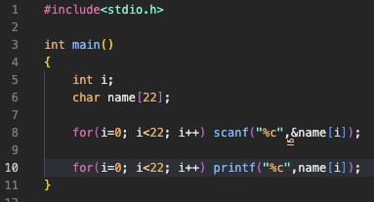
SangMyeong Coding Education
String, 문자열
String, 2D Array
week 9

Slide 4
SangMyeong Coding Education
String, 문자열
0 | 1 | 2 | 3 | 4 | 5 | 6 | 7 | 8 | 9 | 10 | 11 | 12 | 13 | 14 | 15 | 16 | 17 | 18 | 19 | 20 | 21
H | I |  | M | Y |  | N | A | M | E |  | I | S |  | T | A | E | J | E | O | N | G
String, 2D Array
week 9

Slide 5

SangMyeong Coding Education
String, 문자열
0 | 1 | 2 | 3 | 4 | 5 | 6 | 7 | 8 | 9 | 10 | 11 | 12 | 13 | 14 | 15 | 16 | 17 | 18 | 19 | 20 | 21
H | I |  | M | Y |  | N | A | M | E |  | I | S |  | T | A | E | J | E | O | N | G
String, 2D Array
week 9

Slide 6
SangMyeong Coding Education
String, 문자열
0 | 1 | 2 | 3 | 4 | 5 | 6 | 7 | 8 | 9 | 10 | 11 | 12 | 13 | 14 | 15 | 16 | 17 | 18 | 19 | 20 | 21
H | I |  | M | Y |  | N | A | M | E |  | I | S |  | T | A | E | J | E | O | N | G
HI MY NAME IS TAEJEONG
String, 2D Array
week 9

Slide 7
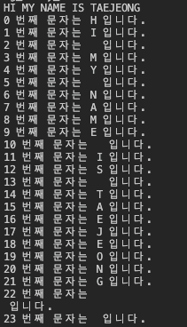
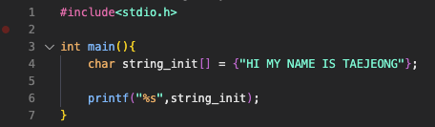
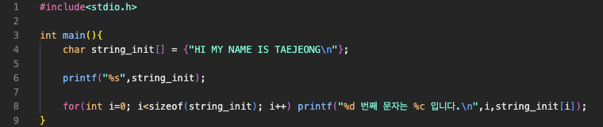
SangMyeong Coding Education
String, 문자열
0 | 1 | 2 | 3 | 4 | 5 | 6 | 7 | 8 | 9 | 10 | 11 | 12 | 13 | 14 | 15 | 16 | 17 | 18 | 19 | 20 | 21 | 22
H | I |  | M | Y |  | N | A | M | E |  | I | S |  | T | A | E | J | E | O | N | G | \n
String, 2D Array
week 9

